Slide 2
MMA841 Operations Management Capacity Analysis
Master of Management Analytics– Session 2
Geoff Pond
Notes:
An example of a title page with more specific program details in the title

Slide 3
Capacity
The capacity of a process is the maximum rate at which it can process customer requests or other units of Work In Progress (WIP).
Colloquially, we often hear terms like throughput or rate of production. In our course, we will call this the flowrate. This is the actual rate that WIP flows through the process.
Capacity is the maximum flowrate the process can attain within the existing resource constraints.

Slide 4
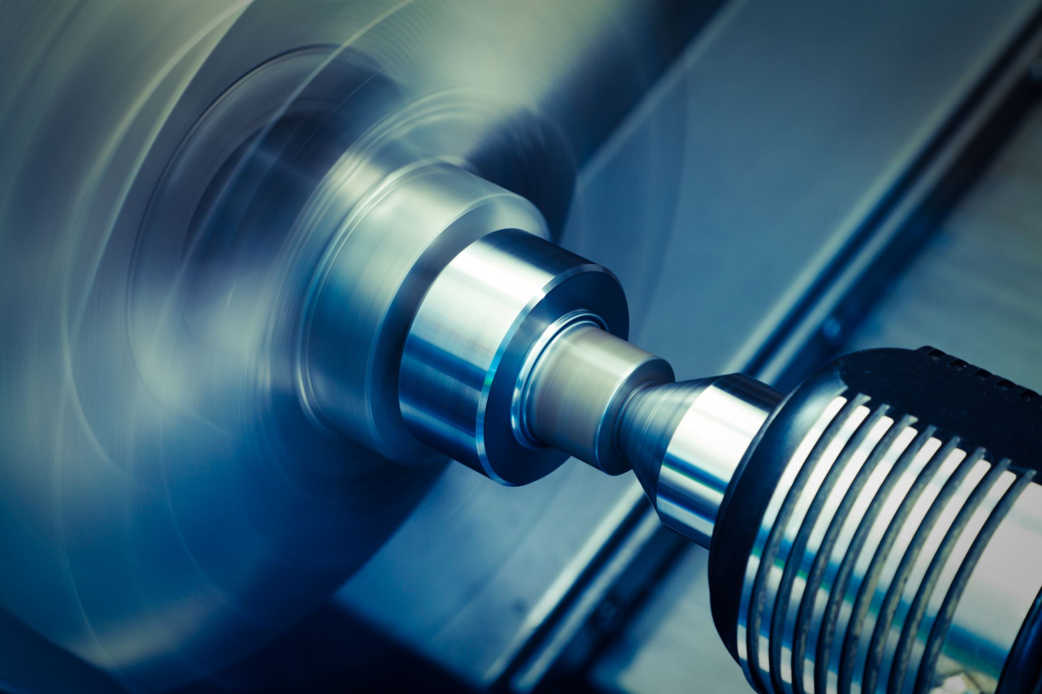
Single Stage Capacity
Consider Bob. Bob works on a lathe in a manufacturing plant. His job is to produce a bushing used in a surgical device. It takes Bob twelve minutes to manufacture a single bushing.
What is Bob’s capacity?

Slide 5
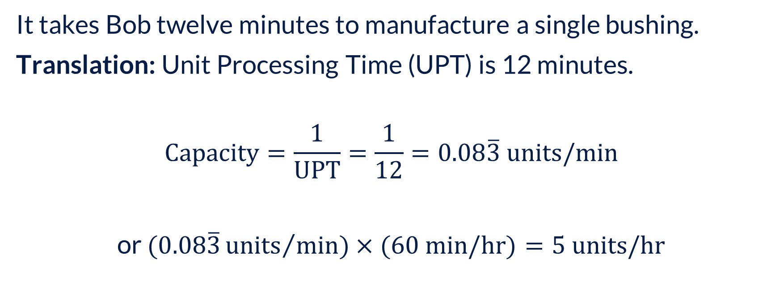
Single Stage Capacity
It takes Bob twelve minutes to manufacture a single bushing.
Translation: Unit Processing Time (UPT) is 12 minutes.
$$\text{Capacity}=\frac{1}{\text{UPT}}=\frac{1}{12}=0.08\overline{3} units/min$$
or $(0.08\overline{3}{units}/{min})$ $×(60 \text{min}\text{/}\text{hr}\text{)}=5 \text{units}\text{/}\text{hr}$

Slide 6
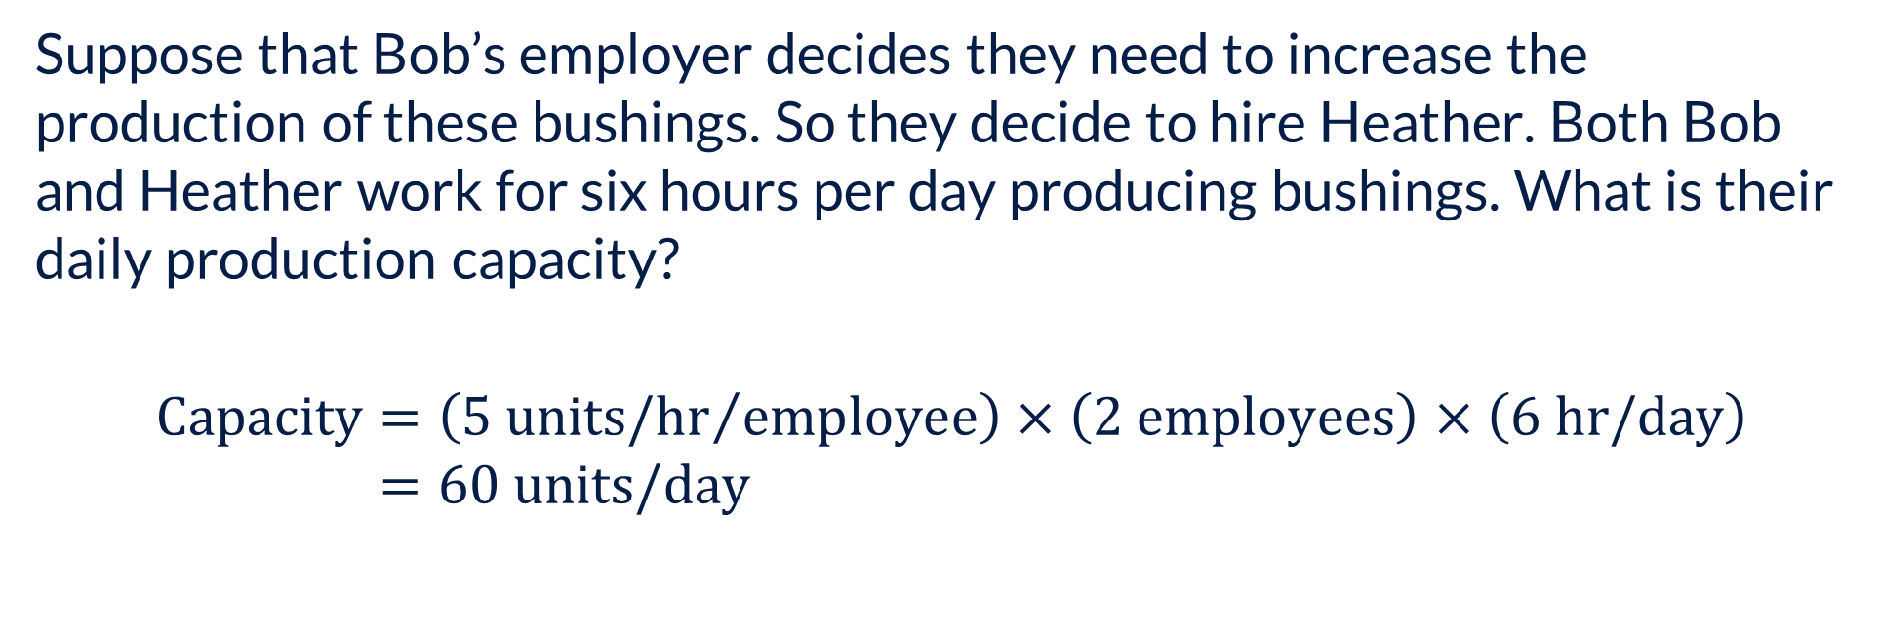
Including Resource Constraints
Suppose that Bob’s employer decides they need to increase the production of these bushings. So they decide to hire Heather. Both Bob and Heather work for six hours per day producing bushings. What is their daily production capacity?
$$\text{Capacity}=\left({5 \text{units}\text{/}\text{hr}}/{employee}\right)×\left(2 \text{employees}\right)×\left(6 \text{hr}\text{/}\text{day}\right) \\ =60 \text{units}\text{/}\text{day}$$

Slide 7
Multi-stage Processes
The vast majority of processes consist of multiple stages. They are often confusing and non-linear in practice. To help us better understand a process, flowcharts are often used to map out a process using the symbology below:
Process Stage
Decision
Buffer
Documentation

Slide 8
Multi-stage Processes - Example
This is a relatively simple process used by a Kingston manufacturer.
Both stamped fins and copper rods (prepared at separate workstations) are assembled together to make a cooling unit.
The process includes reworking units that fail a quality check (leak test) and divergent flow where some units are assembled into a chassis and others are not.

Slide 9
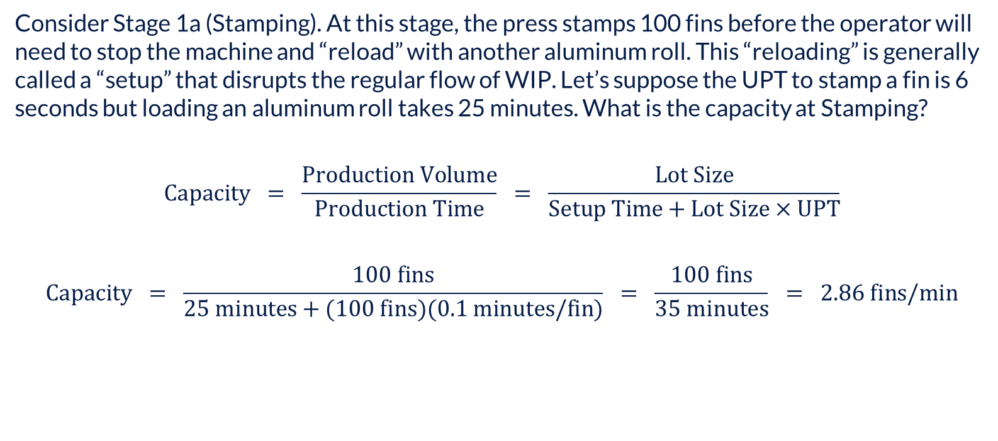
Batching- Example
Consider Stage 1a (Stamping). At this stage, the press stamps 100 fins before the operator will need to stop the machine and “reload” with another aluminum roll. This “reloading” is generally called a “setup” that disrupts the regular flow of WIP. Let’s suppose the UPT to stamp a fin is 6 seconds but loading an aluminum roll takes 25 minutes. What is the capacity at Stamping?
$$\text{Capacity} = \frac{\text{Production} \text{Volume}}{\text{Production} \text{Time}} = \frac{\text{Lot} \text{Size}}{\text{Setup} \text{Time}+\text{Lot} \text{Size}×\text{UPT}}$$
$$\text{Capacity} = \frac{100 \text{fins}}{25 \text{minutes}+(10\text{0 }\text{fins}\text{)(0.1 }\text{minutes}\text{/}\text{fin}\text{)}} = \frac{100 \text{fins}}{35 \text{minutes}} = 2.86 \text{fins}\text{/}\text{min}$$

Slide 10
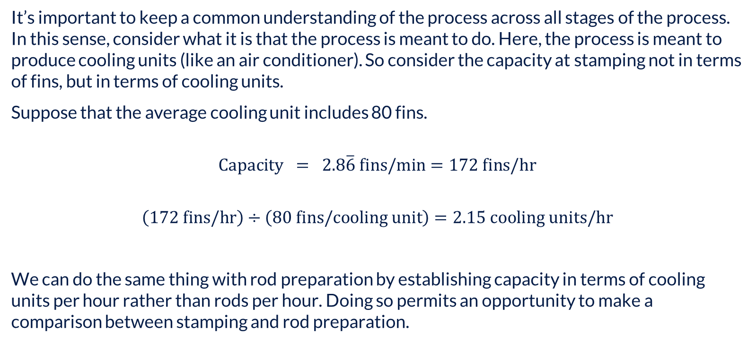
Batching- Example
It’s important to keep a common understanding of the process across all stages of the process. In this sense, consider what it is that the process is meant to do. Here, the process is meant to produce cooling units (like an air conditioner). So consider the capacity at stamping not in terms of fins, but in terms of cooling units.
Suppose that the average cooling unit includes 80 fins.
$$\text{Capacity} = 2.8\overline{6} \text{fins}\text{/}\text{min}=\text{172} \text{fins}\text{/}\text{hr}$$
$$\left(\text{172} \text{fins}\text{/}\text{hr}\right)÷\left(80 \text{fins}\text{/}\text{cooling} \text{unit}\right)=2.15 \text{cooling} \text{units}\text{/}\text{hr}$$
We can do the same thing with rod preparation by establishing capacity in terms of cooling units per hour rather than rods per hour. Doing so permits an opportunity to make a comparison between stamping and rod preparation.

Slide 11
Batching- Now you do one….
Rod Preparation
UPT = 45 seconds
Setup = 15 minutes
This stage includes a single machine supported by a single operator.
A spool of copper tubing generates 120 straightened rods.
On average, a cooling unit contains 50 rods.
What is the capacity of rod preparation in cooling units/hr?

Slide 12
Multi-stage Processes – Where is the Bottleneck?
While even this relatively simple process can seem daunting, we undertake capacity analysis on a stage-by-stage basis just as we did with the single-stage process.
Process Stage | Unit Processing Time (minutes) | Setup Time | Batch Size | Stage Capacity | Constraint on Process Capacity
Stamping | 0.1 mins/fin | 25 mins | 100 fins | 172 fins/hr | 2.15 cooling units/hr
Rod Preparation | 0.75 mins/rod | 15 mins | 120 rods
Assembly | 15 mins/unit | - | - | 4 units/hr | 4 cooling units/hr
Rod Expansion
Brazing
Leak Test | 10 mins/unit | 5 mins | 1 unit | 4 units/hr | 4 cooling units/hr
Chassis Assembly
Packaging
*The data in this table is fictitious

Slide 13
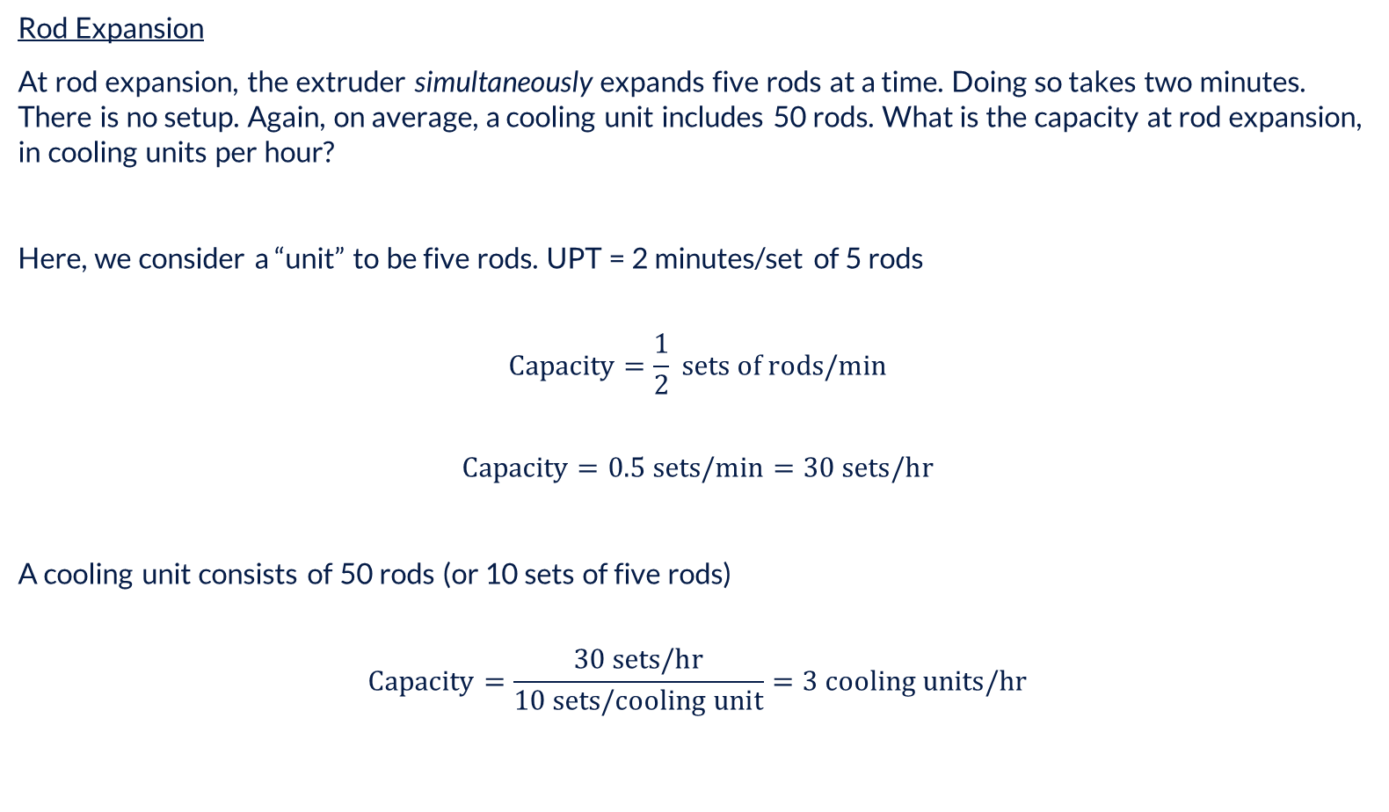
Batching - as in the colloquial “batch”
Rod Expansion
At rod expansion, the extruder simultaneously expands five rods at a time. Doing so takes two minutes. There is no setup. Again, on average, a cooling unit includes 50 rods. What is the capacity at rod expansion, in cooling units per hour?
Here, we consider a “unit” to be five rods. UPT = 2 minutes/set of 5 rods
$$\text{Capacity}=\frac{1}{2} \text{sets} \text{of} \text{rods}\text{/}\text{min}$$
$$\text{Capacity}=0.5 \text{sets}\text{/}\text{min}=30 \text{sets}\text{/}\text{hr}$$
A cooling unit consists of 50 rods (or 10 sets of five rods)
$$\text{Capacity}=\frac{30 \text{sets}\text{/}\text{hr}}{10 \text{sets}\text{/}\text{cooling} \text{unit}}=3 \text{cooling} \text{units}\text{/}\text{hr}$$

Slide 14
Multi-stage Processes – Where is the Bottleneck?
While even this relatively simple process can seem daunting, we undertake capacity analysis on a stage-by-stage basis just as we did with the single-stage process.
Process Stage | Unit Processing Time (minutes) | Setup Time | Batch Size | Stage Capacity | Constraint on Process Capacity
Stamping | 0.1 mins/fin | 25 mins | 100 fins | 172 fins/hr | 2.15 cooling units/hr
Rod Preparation | 0.75 mins/rod | 15 mins | 120 rods | 68.57 rods/hr | 1.37 cooling units/hr
Assembly | 15 mins/unit | - | - | 4 units/hr | 4 cooling units/hr
Rod Expansion | 2 mins/five rods | - | - | 30 sets/hr | 3 cooling units/hr
Brazing
Leak Test | 10 mins/unit | 5 mins | 1 unit | 4 units/hr | 4 cooling units/hr
Chassis Assembly
Packaging
*The data in this table is fictitious

Slide 15
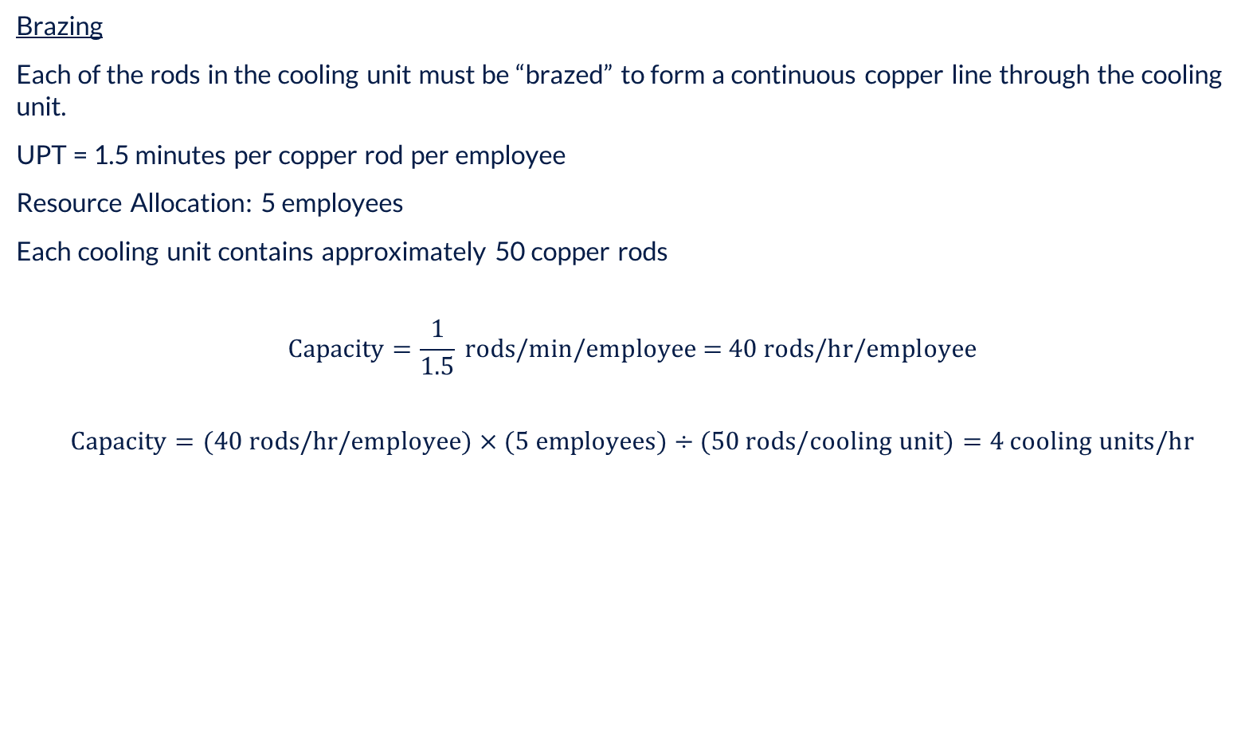
Increased Resource Allocation
Brazing
Each of the rods in the cooling unit must be “brazed” to form a continuous copper line through the cooling unit.
UPT = 1.5 minutes per copper rod per employee
Resource Allocation: 5 employees
Each cooling unit contains approximately 50 copper rods
$$\text{Capacity}=\frac{1}{1.5} \text{rods}\text{/}\text{min}\text{/}\text{employee}\text{ = 40 }\text{rods}\text{/}\text{hr}\text{/}\text{employee}$$
$$\text{Capacity}=\text{(}\text{40 }\text{rods}\text{/}\text{hr}\text{/}\text{employee}\text{)}×(5 \text{employees})÷(50 \text{rods}\text{/}\text{cooling} \text{unit}\text{)}=4 \text{cooling} \text{units}\text{/}\text{hr}$$

Slide 16
Multi-stage Processes – Where is the Bottleneck?
While even this relatively simple process can seem daunting, we undertake capacity analysis on a stage-by-stage basis just as we did with the single-stage process.
Process Stage | Unit Processing Time (minutes) | Setup Time | Batch Size | Stage Capacity | Constraint on Process Capacity
Stamping | 0.1 mins/fin | 25 mins | 100 fins | 172 fins/hr | 2.15 cooling units/hr
Rod Preparation | 0.75 mins/rod | 15 mins | 120 rods | 68.57 rods/hr | 1.37 cooling units/hr
Assembly | 15 mins/unit | - | - | 4 units/hr | 4 cooling units/hr
Rod Expansion | 2 mins/five rods | - | - | 30 sets/hr | 3 cooling units/hr
Brazing | 1.5 mins/rod | - | - | 200 rods/hr | 4 cooling units/hr
Leak Test | 10 mins/unit | 5 mins | 1 unit | 4 units/hr | 4 cooling units/hr
Chassis Assembly
Packaging
*The data in this table is fictitious

Slide 17
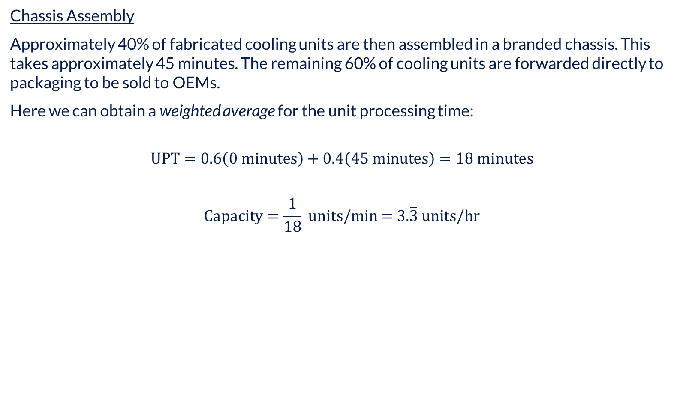
Product Mix at Chassis Assembly
Chassis Assembly
Approximately 40% of fabricated cooling units are then assembled in a branded chassis. This takes approximately 45 minutes. The remaining 60% of cooling units are forwarded directly to packaging to be sold to OEMs.
Here we can obtain a weighted average for the unit processing time:
$$\text{UPT}=0.6\left(0 \text{minutes}\right)+0.4\left(45 \text{minutes}\right)=18 \text{minutes}$$
$$\text{Capacity}=\frac{1}{18} \text{units}\text{/}\text{min}\text{ = 3.}\overline{3} \text{units}\text{/}\text{hr}$$

Slide 18
Multi-stage Processes – Where is the Bottleneck?
While even this relatively simple process can seem daunting, we undertake capacity analysis on a stage-by-stage basis just as we did with the single-stage process.
Process Stage | Unit Processing Time (minutes) | Setup Time | Batch Size | Stage Capacity | Constraint on Process Capacity
Stamping | 0.1 mins/fin | 25 mins | 100 fins | 172 fins/hr | 2.15 cooling units/hr
Rod Preparation | 0.75 mins/rod | 15 mins | 120 rods | 68.57 rods/hr | 1.37 cooling units/hr
Assembly | 15 mins/unit | - | - | 4 units/hr | 4 cooling units/hr
Rod Expansion | 2 mins/five rods | - | - | 30 sets/hr | 3 cooling units/hr
Brazing | 1.5 mins/rod | - | - | 200 rods/hr | 4 cooling units/hr
Leak Test | 10 mins/unit | 5 mins | 1 unit | 4 units/hr | 4 cooling units/hr
Chassis Assembly | 45 mins/unit | - | - | 1.3 units/hr | 3.3 cooling units/hr
Packaging
*The data in this table is fictitious

Slide 19

Packaging
Packaging
Suppose that, regardless of whether the unit is assembled into a chassis or not, it takes 20 minutes to frame the unit into a skid and shrink-wrap it.
$$\text{UPT}=20 \text{minutes}$$
$$\text{Capacity}=\frac{1}{20} \text{units}\text{/}\text{min} ×\text{60 }\text{mins}\text{/}\text{hr}\text{= 3 }\text{units}\text{/}\text{hr}$$

Slide 20
Multi-stage Processes – Where is the Bottleneck?
The process capacity is a function of the bottleneck stage (the stage having the lowest capacity).
This process has a capacity of 1.37 cooling units/hr.
Process Stage | Unit Processing Time (minutes) | Setup Time | Batch Size | Stage Capacity | Constraint on Process Capacity
Stamping | 0.1 mins/fin | 25 mins | 100 fins | 172 fins/hr | 2.15 cooling units/hr
Rod Preparation | 0.75 mins/rod | 15 mins | 120 rods | 68.57 rods/hr | 1.37 cooling units/hr
Assembly | 15 mins/unit | - | - | 4 units/hr | 4 cooling units/hr
Rod Expansion | 2 mins/five rods | - | - | 30 sets/hr | 3 cooling units/hr
Brazing | 1.5 mins/rod | - | - | 200 rods/hr | 4 cooling units/hr
Leak Test | 10 mins/unit | 5 mins | 1 unit | 4 units/hr | 4 cooling units/hr
Chassis Assembly | 45 mins/unit | - | - | 1.3 units/hr | 3.3 cooling units/hr
Packaging | 20 mins/unit | - | - | 3 units/hr | 3 cooling units/hr
*The data in this table is fictitious

Slide 21


Utilisation
Utilisation is the proportion of the time that a resource (whether human or machine) is busy:
$$\text{Utilisation}=\frac{\text{Flowrate}}{\text{Capacity}}$$
Process Stage | Unit Processing Time (minutes) | Setup Time | Batch Size | Stage Capacity | Constraint on Process Capacity
Rod Preparation | 0.75 mins/rod | 15 mins | 120 rods | 68.57 rods/hr | 1.37 cooling units/hr
Chassis Assembly | 45 mins/unit | - | - | 1.3 units/hr | 3.3 cooling units/hr
The actual flowrate through the process cannot exceed the process capacity. So at best, the utilisation at Chassis Assembly is:
$$\text{Utilisation}=\frac{\text{1.37}}{\text{3.}\overline{3}}=41.1\%$$

Slide 22
Load Balancing (Takt Time)
Clearly, paying an employee to work when they actually do work only 41.1% of the time is a bit absurd.
The smart play is to reallocate labour until the utilisation at each process stage is approximately the same.
In our example, we would reallocate labour from assembly to rod preparation (together with another machine).
Of course, we would only reallocate labour if the process capacity fell short of the demand rate. Otherwise, layoffs are among the options. But be careful – if the demand rate picks back up, those employees may be difficult to re-engage.

Slide 23
Capacity – Other Things to Think About
Adding resources doesn’t always result in a proportional increase in capacity. For example, do five members of a case team require one-fifth the time an individual would require to complete a case? Probably not – although the quality should be better.
Learning and Forgetting. It’s well documented that workers naturally become more proficient at their jobs over time (“learning curves”) but when removed from that work, they also tend to lose proficiency (“forgetting curves”)
In this sense, the “Unit Processing Time” often varies by employee– especially in professional occupations (accounting, medical, software development, etc.)
For repetitive tasks, technology has largely overtaken manual labour and even for non-repetitive tasks, machine learning and artificial intelligence are making fast gains.
In many cases, tasks can be done simultaneously to reduce the process flowtime (e.g., doing a setup for a downstream task while the upstream task continues the upstream activity on the same unit)

Slide 24
Questions?

Slide 25
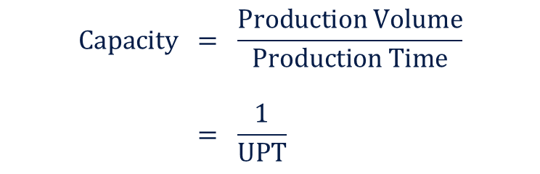
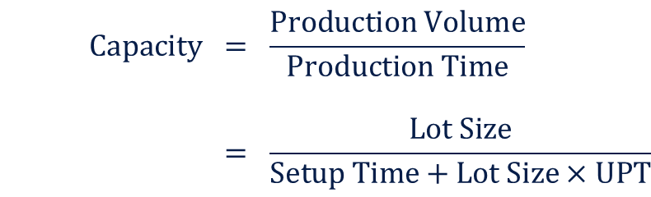

Useful Formulas
Stage Without Flow Interruption
Stage With Flow Interruption
$$\text{Capacity} = \frac{\text{Production} \text{Volume}}{\text{Production} \text{Time}} \\ = \frac{\text{1}}{\text{UPT}}$$
$$\text{Capacity} = \frac{\text{Production} \text{Volume}}{\text{Production} \text{Time}} \\ = \frac{\text{Lot} \text{Size}}{\text{Setup} \text{Time}+\text{Lot} \text{Size}×\text{UPT}}$$
$$\text{Recommended} \text{Lot} \text{Size} = \frac{\text{FR}×\text{Setup} \text{Time}}{1−\text{FR}×\text{UPT}}$$

